Slide 1
Image Feature Correspondences for Camera Calibration
Software Requirements Specification
Kiran Singh
CAS 741
2025-01-24

Slide 2
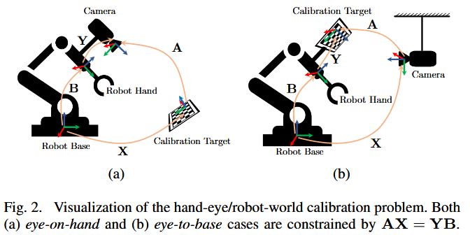
Overview
Cameras need to be calibrated to provide useful data
Current methods face trade-offs. Inclusive of:
local solver tools
pre-known calibration targets/features of known scale within the environment
Overlap in camera fields-of-view (FOV)
Thesis goal is to ‘robustify’ calibration in comparison to SOTA methods
Envisioned to be completed in two steps:
Identify features from ‘keypoints’ in imagery data
Compute robotic posed transforms in HERW formulation via a global optimization algorithm
[1] Y. Wang, W. Jiang, K. Huang, S. Schwertfeger, and L. Kneip, “Accurate Calibration of Multi-Perspective Cameras from a Generalization of the Hand-Eye Constraint,” in 2022 International Conference on Robotics and Automation (ICRA), Philadelphia, PA, USA: IEEE, May 2022, pp. 1244–1250. doi: 10.1109/ICRA46639.2022.9811577.

Slide 3
Goals Statements
Provided the configuration data of each camera, inclusive of the intrinsic parameters and imagery streams, and the ground-truth robot pose, the goals of this software are:
Goal ID | Description
GS01 | Define a collection of features from each image frame.
GS02 | Define the criteria used to compare identified features between separate image frames.
GS03 | Compare the identified features from GS01 between each image frame.
GS04 | Compute the number of matches in each image frame per the criteria in GS02.
GS05 | Generate a report of the matched features between each image.

Slide 4
Assumptions
Goal ID | Description
A01 | The ambient illumination conditions remain constant between successive images.
A02 | Overlap between the FOV of any cameras is not guaranteed.
A03 | Features may be extracted from each camera frame. *
A04 | All supplied imagery is produced by a pinhole model, affine camera. [TM01]
A05 | Intrinsic calibration parameters are static for each camera. [TM01]
A06 | The transform between the robot coordinate measurement and the robot base frame is assumed to be used as an input.
A07 | Camera lens distortion can be ignored [TM01].

Slide 5
Inputs and Outputs
Inputs
In1) Camera configuration parameters
In1A) Quantity of cameras, i (i >0)
In1B) Camera Intrinsic Parameters (TM01)
In2) Robot Pose Ground Truth (P_{i})
Global Position of end-effector
Translation (Cartesian Coordinates)
Rotation (Roll, Pitch, Yaw – const. from –π < θ ≤ π)
In3) Imagery stream data
For pose P_{i} and camera C_{j}
Imagery resolution, m _{x} n, (m, n > 0)
Imagery vector **
In4) Feature Detector Algorithm*
In5) Feature Comparison Comparison**
Outputs
For each camera, C
Out1) For each image, i:
A graph of identified features and its constitutive points
Out2) A graph of each matched feature with the corresponding camera, image frame, and matched feature
Out3) A confidence metric for each matched feature
Out4) A list of transforms to be calculated between each matched feature
Notes:
How do we encapsulate the Feature Detector and Feature Comparison Algorithms

Slide 6
Theoretical Models
Need to redefine how the theoretical models are defined such that we do not over specify:
What time of feature detection/matching algorithm are employed
What the selection criteria are of a correspondence, for similar reasons to (1)
ID | Description
TM01 | Intrinsic Camera Parameter, K
TM02 | Integral Image
TM03 | Hessian-Based Interest Points [LC01]

Slide 7
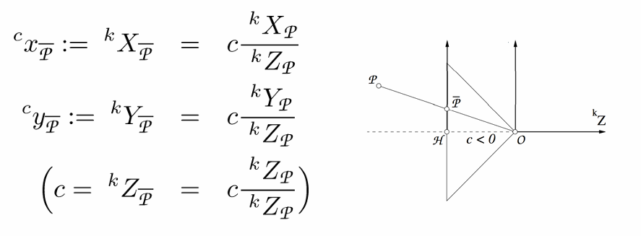
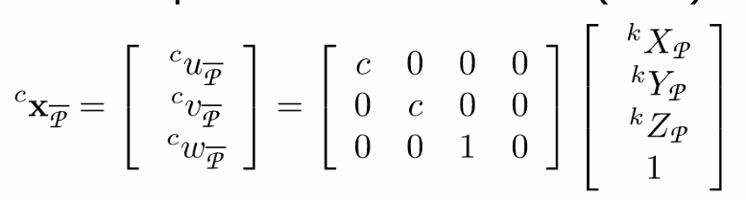

Theoretical Models – TM01
For a known point, P, we obtain its coordinates on the 2D image plane
Assumptions
Pinhole camera model – A04
Lens distortion is ignored camera model – A07
Initial Calibration Parameters (K) are static – A05
C. Stachniss. (2021). Camera Parameters: Extrinsics and Intrinsics [Online]. Available: https://www.ipb.uni-bonn.de/html/teaching/photo12-2021/2021-pho1-20-camera-params.pptx.pdf.

Slide 8
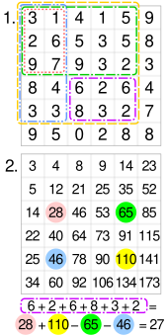

Theoretical Models – TM02
For point X in a given image, a summed image contains the summation of the image intensity for all pixels formed by the origin and point X.
D. Tyagi, “Introduction to SURF (Speeded-Up Robust Features),” Medium, Apr. 07, 2020. https://medium.com/@deepanshut041/introduction-to-surf-speeded-up-robust-features-c7396d6e7c4e
‌‌
Wikipedia Contributors, “Summed-area table,” Wikipedia, Sep. 21, 2019. https://en.wikipedia.org/wiki/Summed-area_table
‌

Slide 9
Theoretical Models – TM03
For point X in a given image, a summed image contains the summation of the image intensity for all pixels formed by the origin and point X.
D. Tyagi, “Introduction to SURF (Speeded-Up Robust Features),” Medium, Apr. 07, 2020. https://medium.com/@deepanshut041/introduction-to-surf-speeded-up-robust-features-c7396d6e7c4e
‌‌
Wikipedia Contributors, “Summed-area table,” Wikipedia, Sep. 21, 2019. https://en.wikipedia.org/wiki/Summed-area_table
‌

Slide 10
General Definitions
Correspondence – a flag between two identified features from separate images which exceeds the comparison threshold as defined in the Feature Comparison Algorithm

Slide 11
Draft Instanced Models

Slide 12
Likely Changes
TM03 may be deleted as it over specifies the methodology of what algorithm should be used

Slide 13
Functional / Non-Functional Requirements
Future Work
To be discussed following revisions to TM, GD, DD, and IMs

